Slide 1

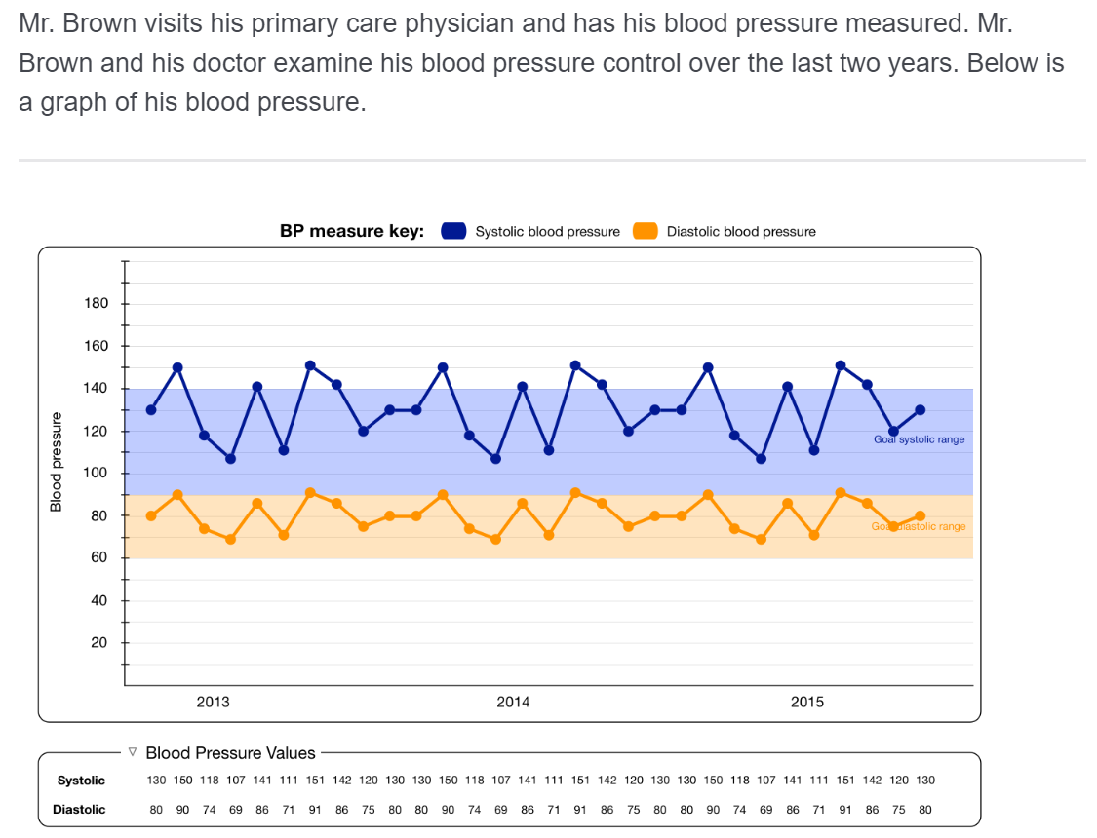
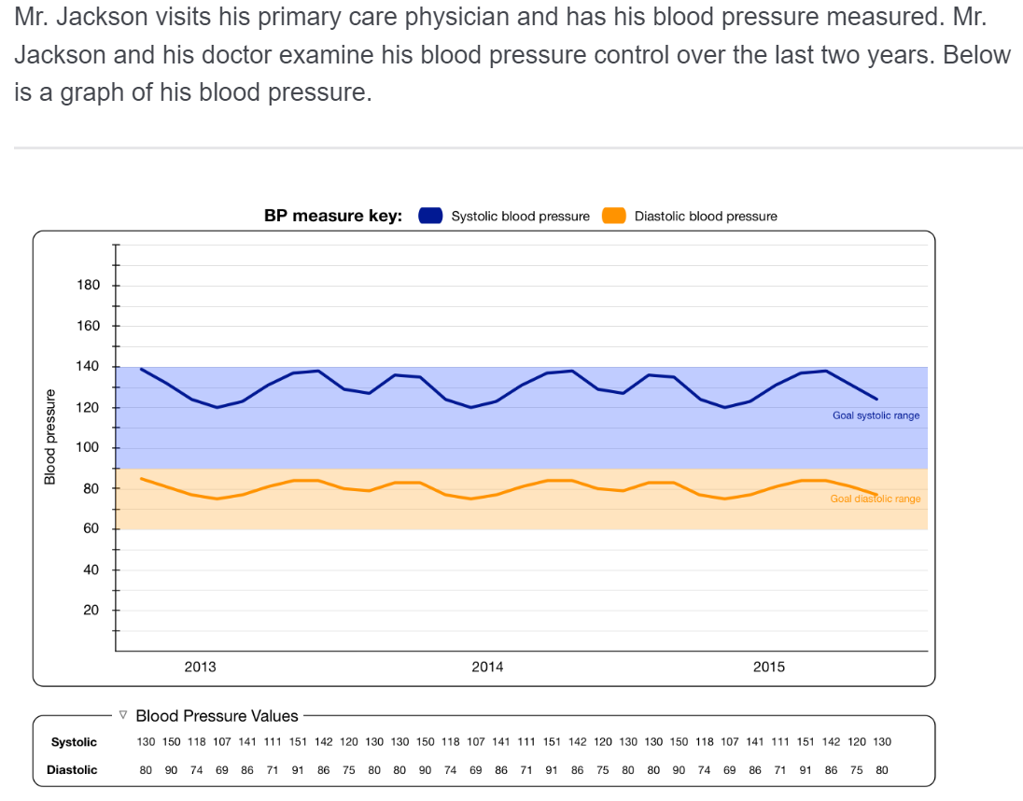
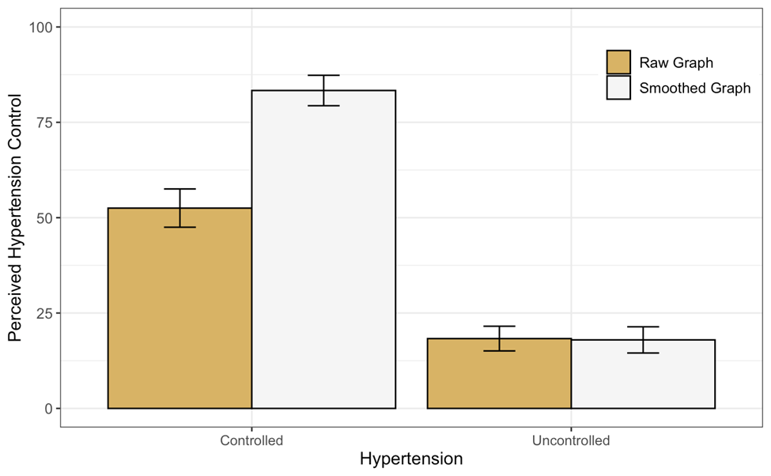
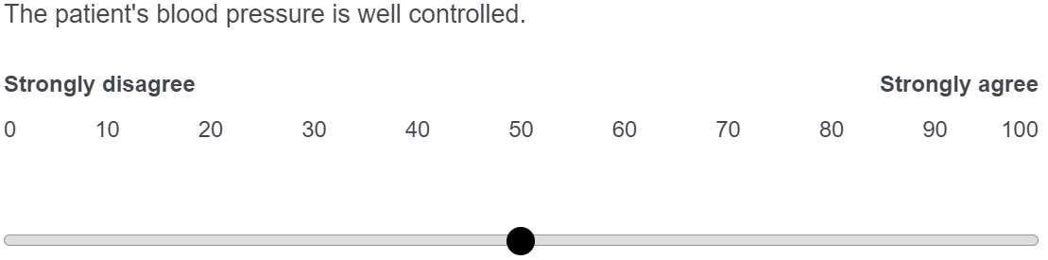
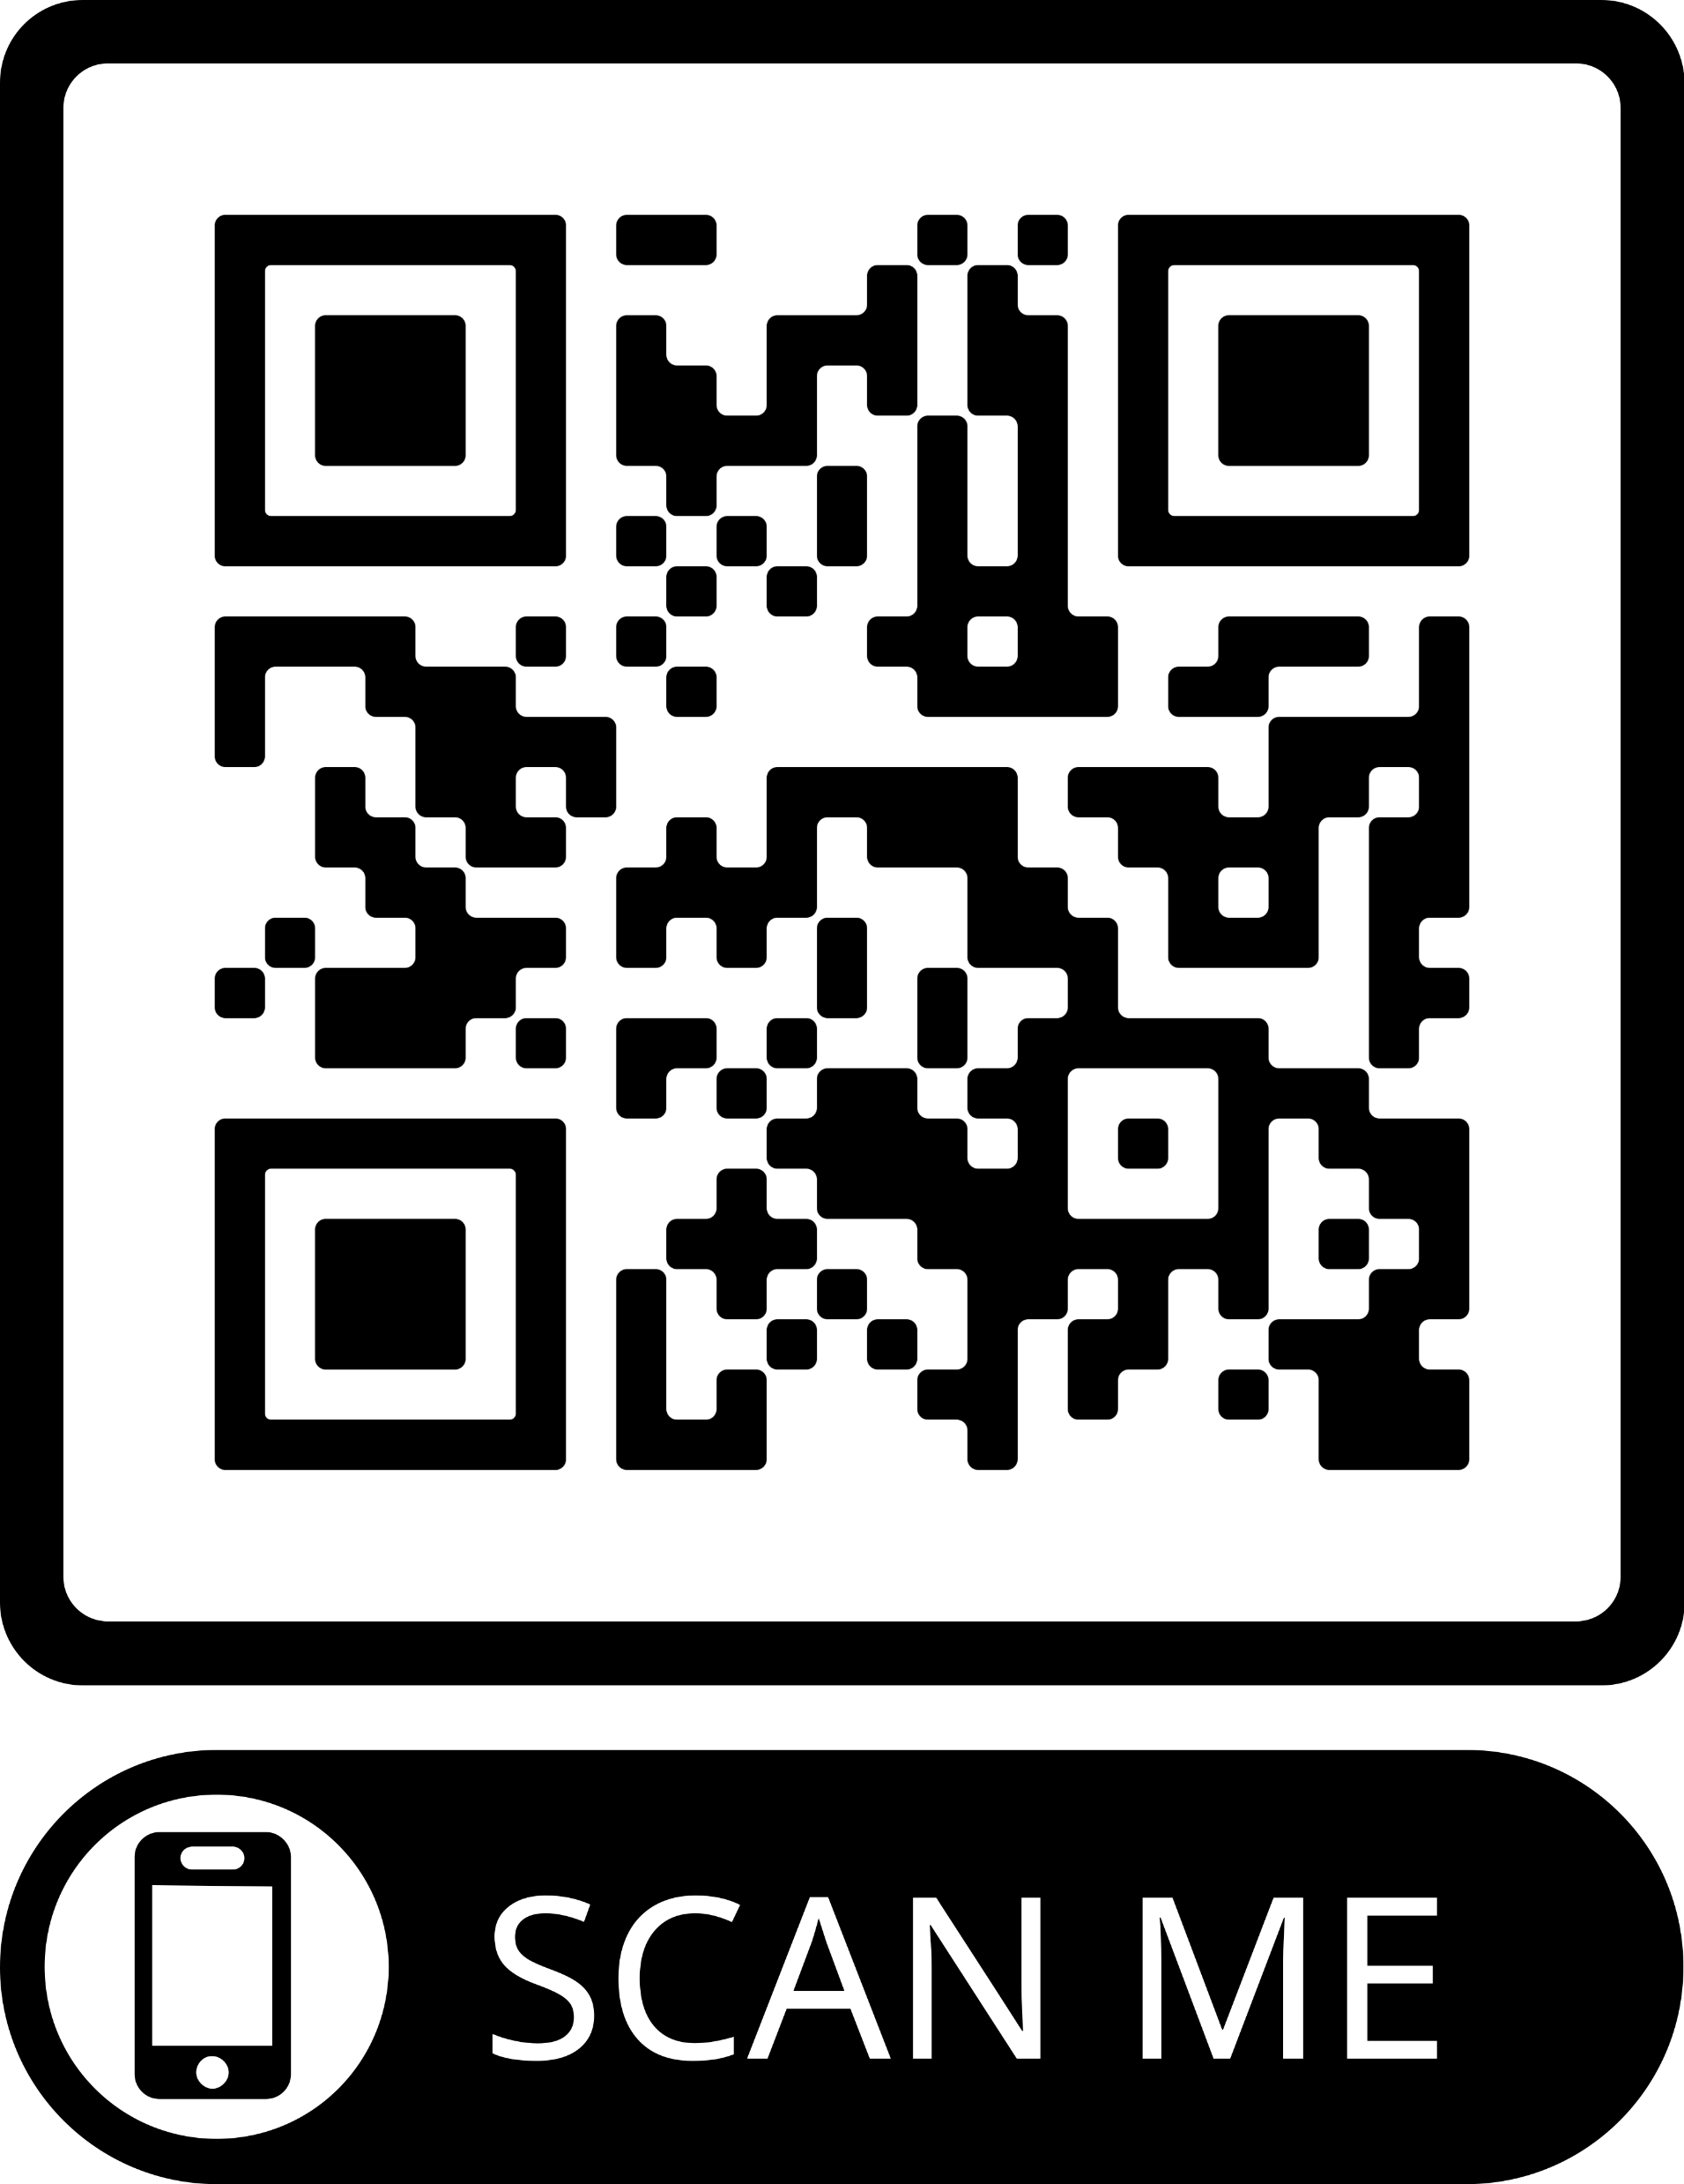
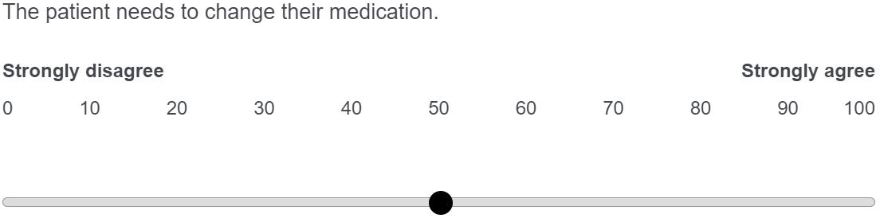



Physicians judge hypertension control more accurately when viewing ‘smoothed’ graphs.
Non-Cognitive Predictors of Student Success: A Predictive Validity Comparison Between Domestic and International Students
The Impact of an Enhanced Data Visualization Tool for Hypertension in the Electronic Health Record on Physician Judgments about Hypertension Control
‘Raw’ Graph – Systolic BP Mean: 130, SD: 15
AMMO BAR
Delete this and replace it with your…
Extra Graphs
Extra Correlation tables
Extra Figures
Extra nuance that you’re worried about leaving out.
Keep it messy! This section is just for you.
PRESENTER:
Sean X. Duan
BACKGROUND:
One contributor to uncontrolled hypertension is ‘clinical inertia’ due to inaccurate judgements of patient blood pressure control. This can stem from significant variance between BP measurements over time.
We designed new data visualizations to reduce clinical uncertainty and improve physician judgement.
METHODS
57 family medicine physicians were recruited internally through e-mail.
Physicians assessed 8 brief vignettes of a fictitious patient
For each vignette, participants Rated perceived hypertension control and need for medication change
Vignettes systematically varied in mean systolic BP (130 or 145 mmHg), standard deviation of BP (15 or 25), and form of data visualization (line graph with raw data or smoothed values)
RESULTS
Smoothed graphs were appropriately judged to have greater control than raw graphs in the controlled BP condition, but not the uncontrolled BP condition.
High BP variability resulted in lower perception of control and greater need for medication change
‘Smoothed’ Graph – Systolic BP Mean: 130, SD: 15
Take a picture to download the abstract and poster
Sean Duan, Victoria A Shaffer, Pete Wegier, KD Valentine, Shannon M. Canfield, Jeffery L. Belden, Linsey M. Steege, Mihail Popescu, Richelle J. Koopman
sxdff5@mail.missouri.edu
Notes:
Notes:
In Powerpoint, click View > Guides
Keep text within gutter guides.
Author list: Don’t split names onto two lines (e.g., “Jimmy [break] Smith”). If that happens, use a new line, unless you need the space. Bold the first names of anybody who’s presenting in person.
Intro/methods/result: Do not drop below font size 28, but if you have extra space, jack up the font size until the space is full.
Do not use color in the sidebars except in graphs/figures. It’ll pull attention from the center and slow interpretation for passersby.

